Slide 1
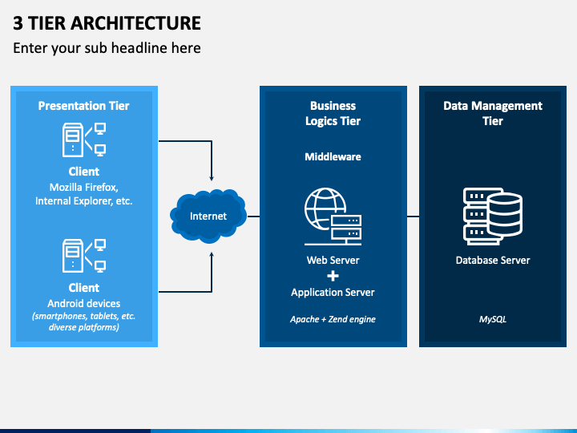
.

Slide 2
Group Members And Mentor.
MENTOR AND TEAM LEADER
Mr. Anushree Sah
And Tushar Mittal
NAME | PHONE NO. | SAP ID | BRANCH
ASHWANI SINGH | 6387928434 | 500068763 | CLOUD
AYUSH KUMAR TODARIA | 9129303313 | 500069522 | BFSI
AMAAN ANSARI | 8941919008 | 500067262 | CLOUD
GAURAV GUPTA | 8949081342 | 500068658 | CLOUD

Slide 3
Index
Objective
Abstract
Introduction
Technology used
Project Demonstration

Slide 4
Objective
To implement infrastructure as code for your Azure solutions, use Azure Resource Manager templates (ARM templates).

Slide 5
Abstract
Three-tier architecture is a well-established software application architecture that organizes applications into three logical and physical computing tiers: the presentation tier, or user interface; the application tier, where data is processed; and the data tier, where the data associated with the application is stored and managed.
The chief benefit of three-tier architecture is that because each tier runs on its own infrastructure, each tier can be developed simultaneously by a separate development team, and can be updated or scaled as needed without impacting the other tiers.

Slide 6
Introduction
A 3-tier architecture is a type of software architecture which is composed of three “tiers” or “layers” of logical computing. They are often used in applications as a specific type of client-server system. 3-tier architectures provide many benefits for production and development environments by modularizing the user interface, business logic, and data storage layers. Doing so gives greater flexibility to development teams by allowing them to update a specific part of an application independently of the other parts. This added flexibility can improve overall time-to-market and decrease development cycle times by giving development teams the ability to replace or upgrade independent tiers without affecting the other parts of the system.

Slide 7
Evolution of 3-Tier Architecture
Single Tier
Dual Tier
3-Tier
………..
N Tier

Slide 8
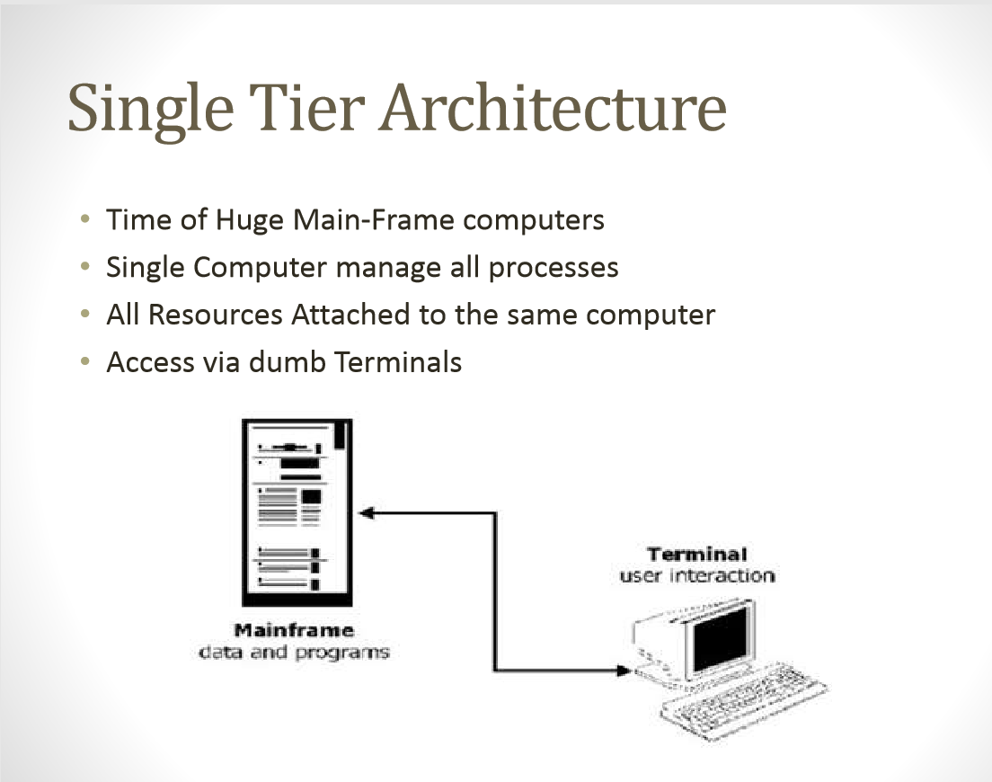

Slide 9
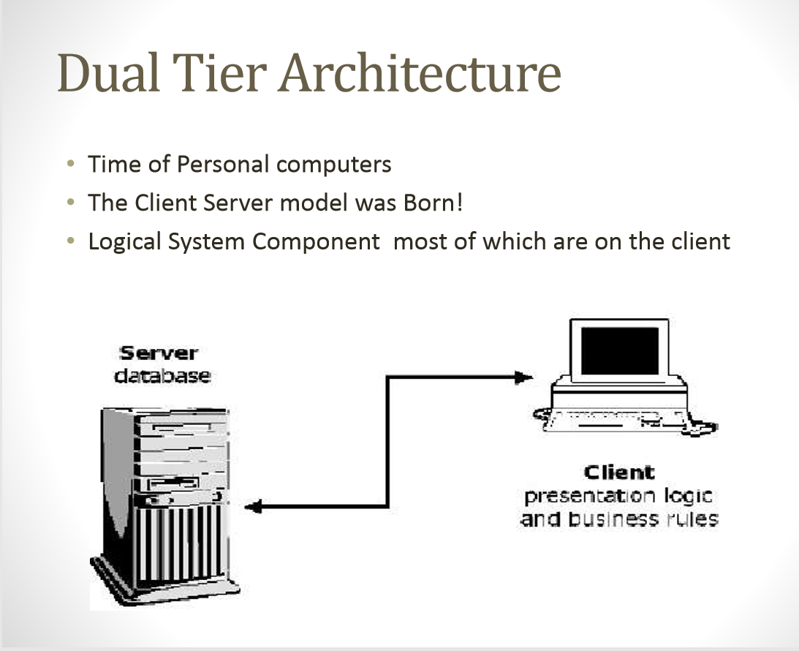

Slide 10
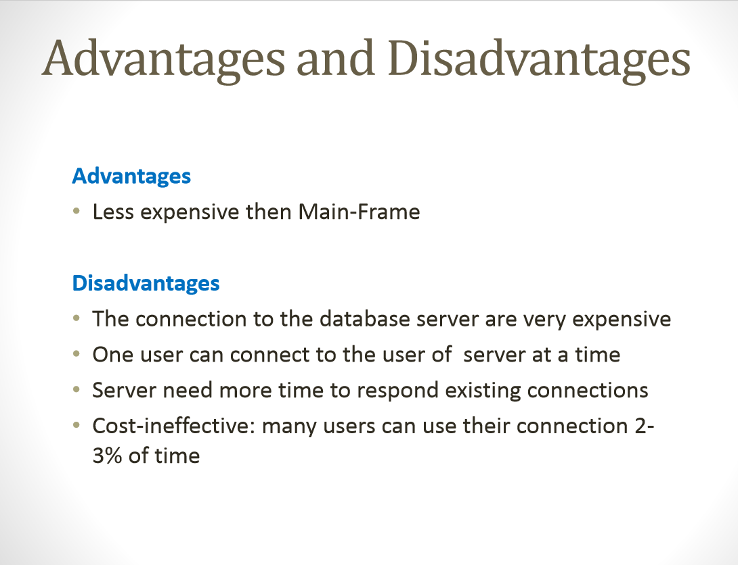

Slide 11
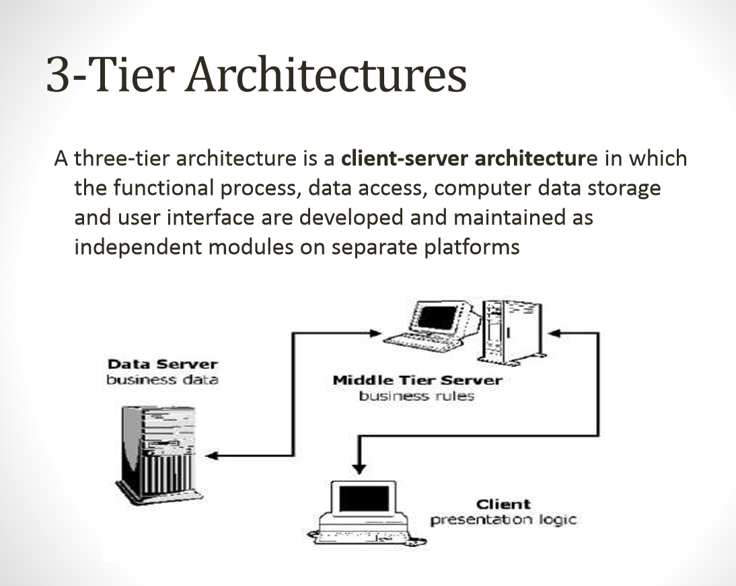

Slide 12
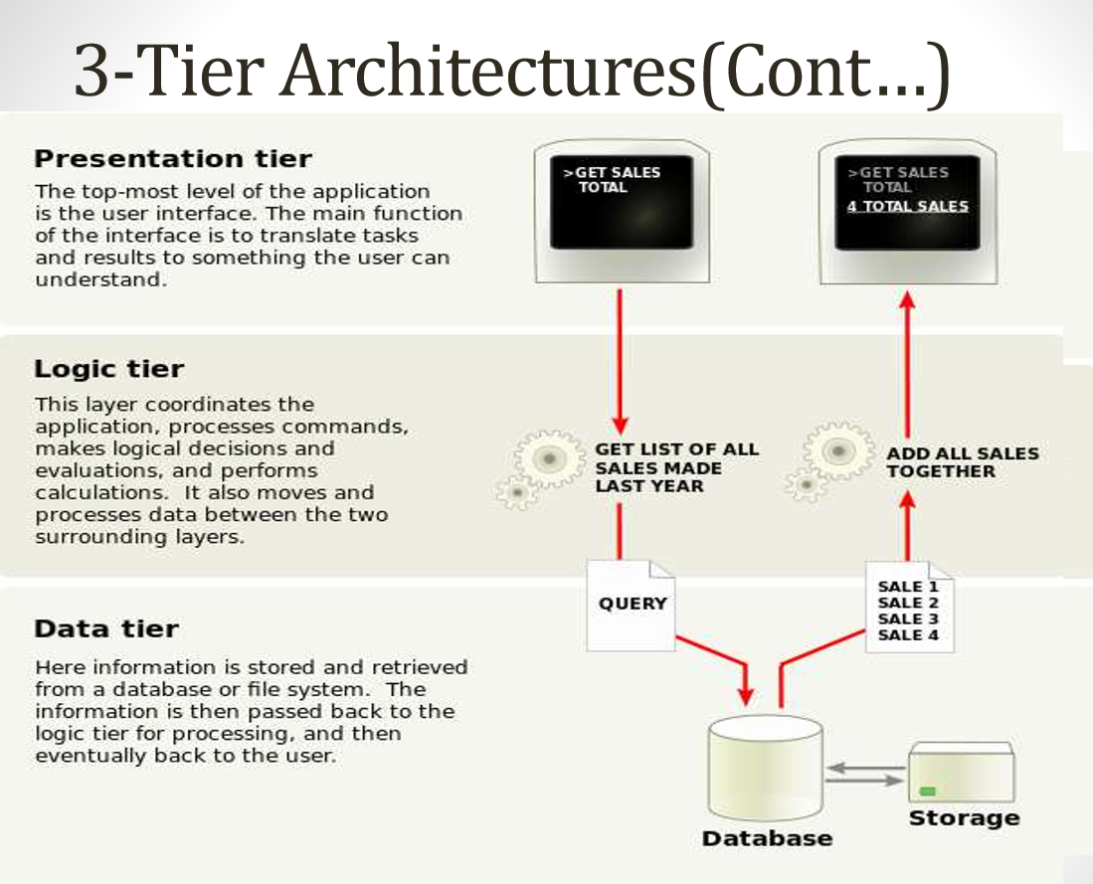

Slide 13
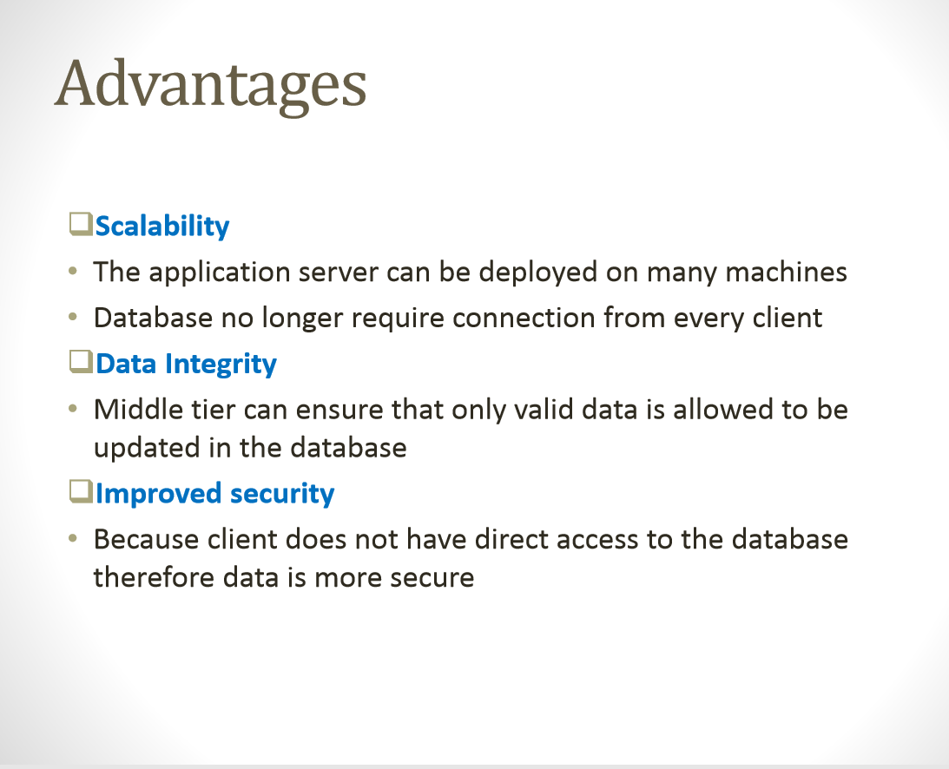

Slide 14
Technology used
The template is a JavaScript Object Notation
(JSON) file that defines the infrastructure and configuration for your project. The template uses declarative syntax, which lets you state what you intend to deploy without having to write the sequence of programming commands to create it. In the template, you specify the resources to deploy and the properties for those resources.

Slide 15
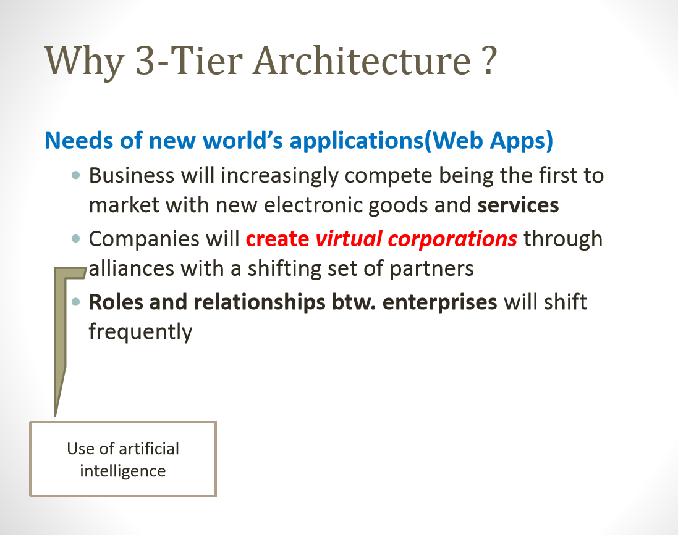

Slide 16
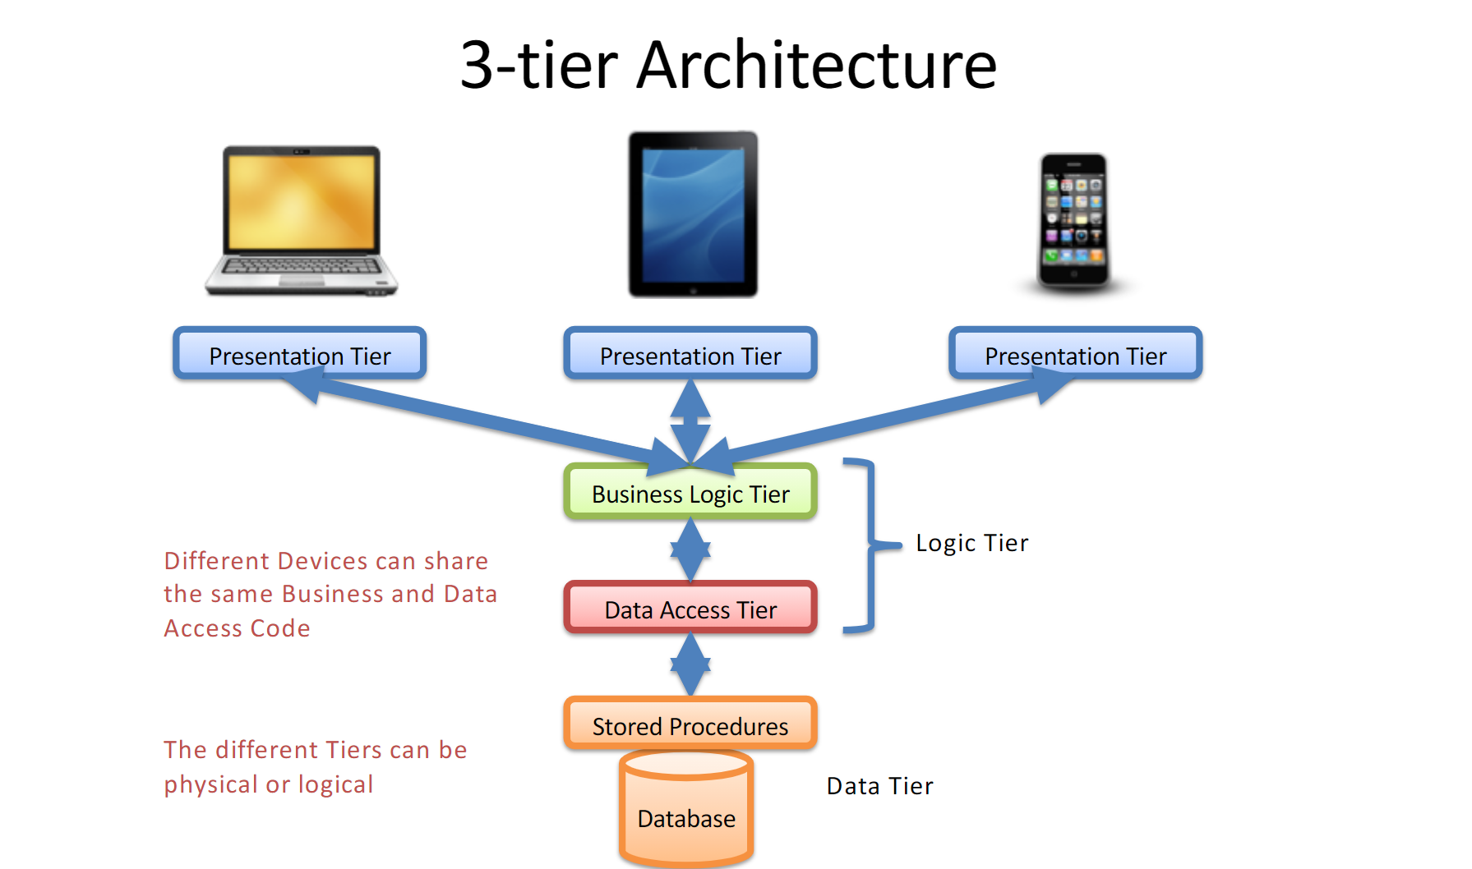

Slide 17
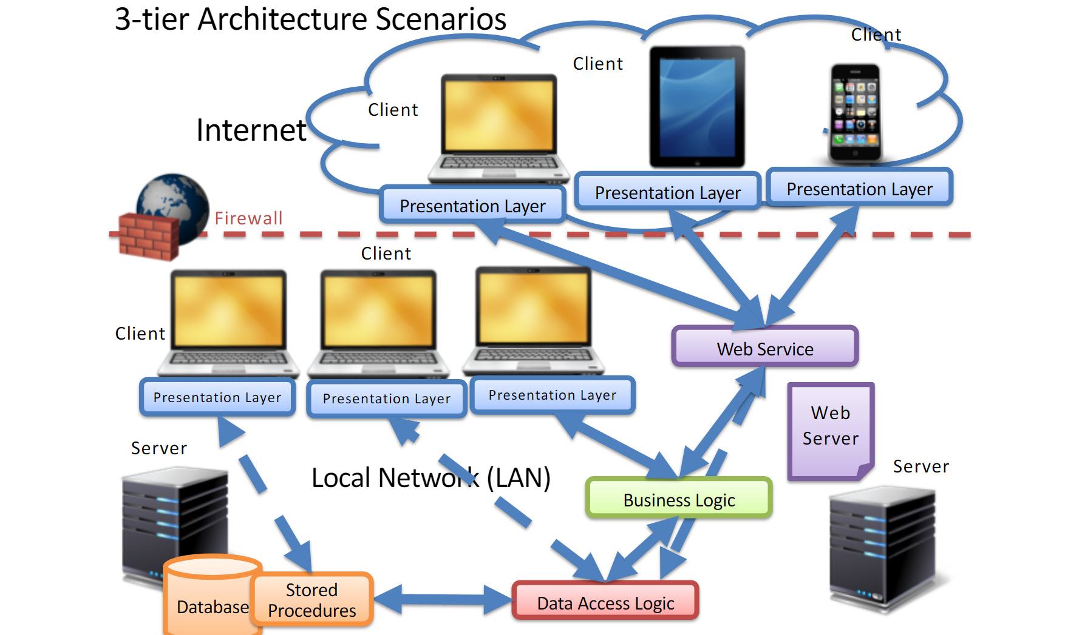

Slide 18
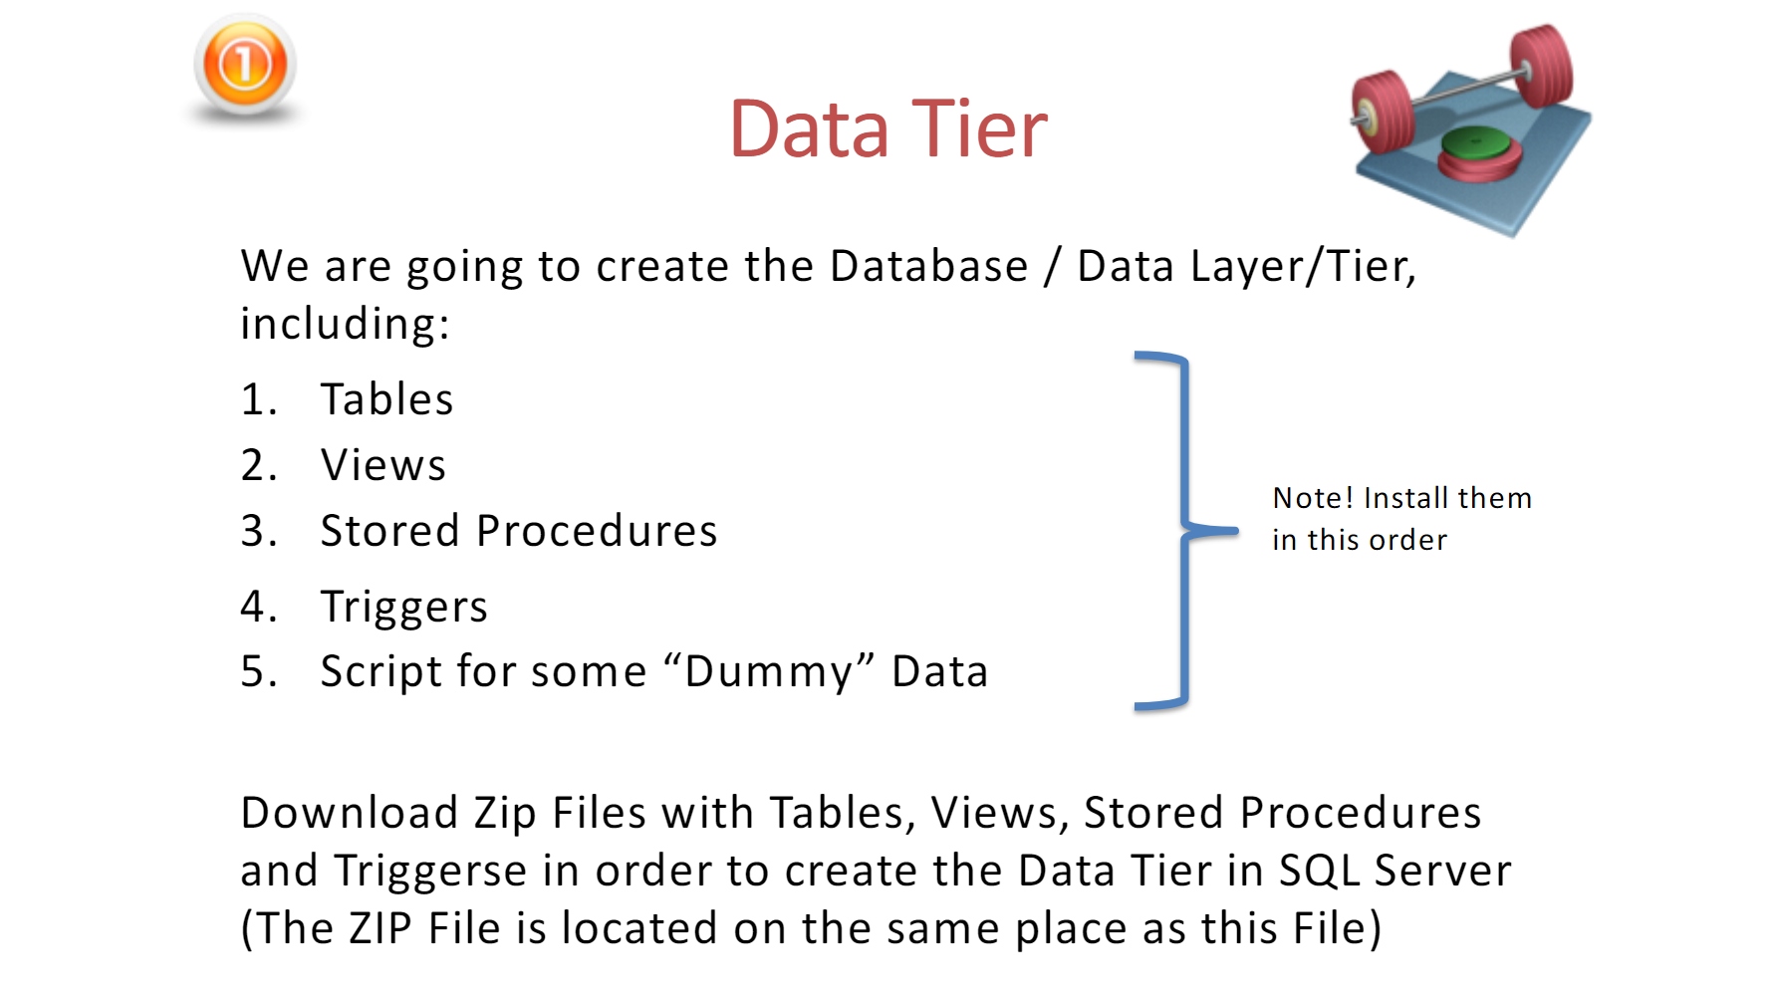

Slide 19
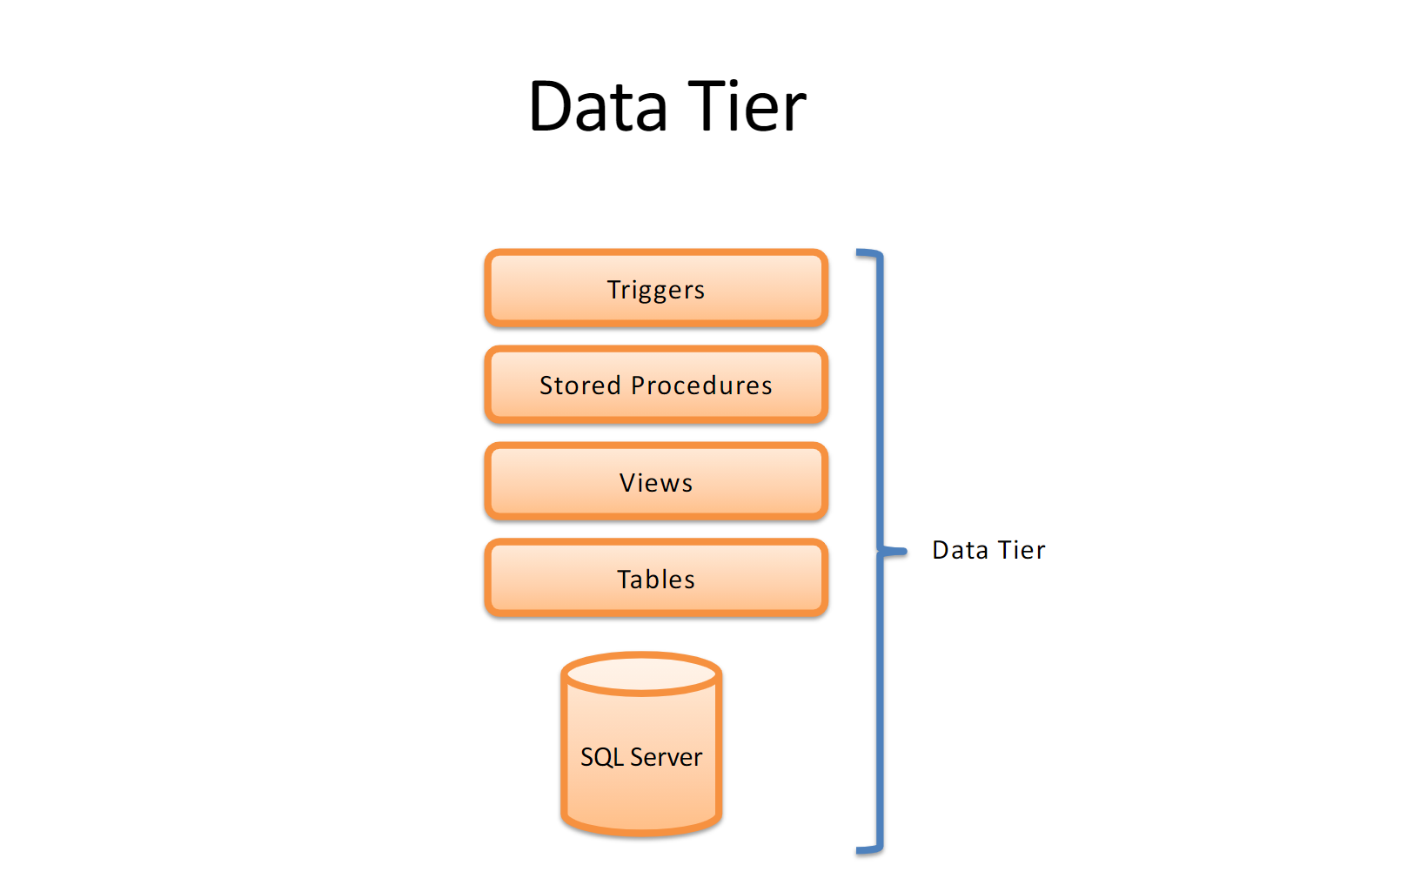

Slide 20
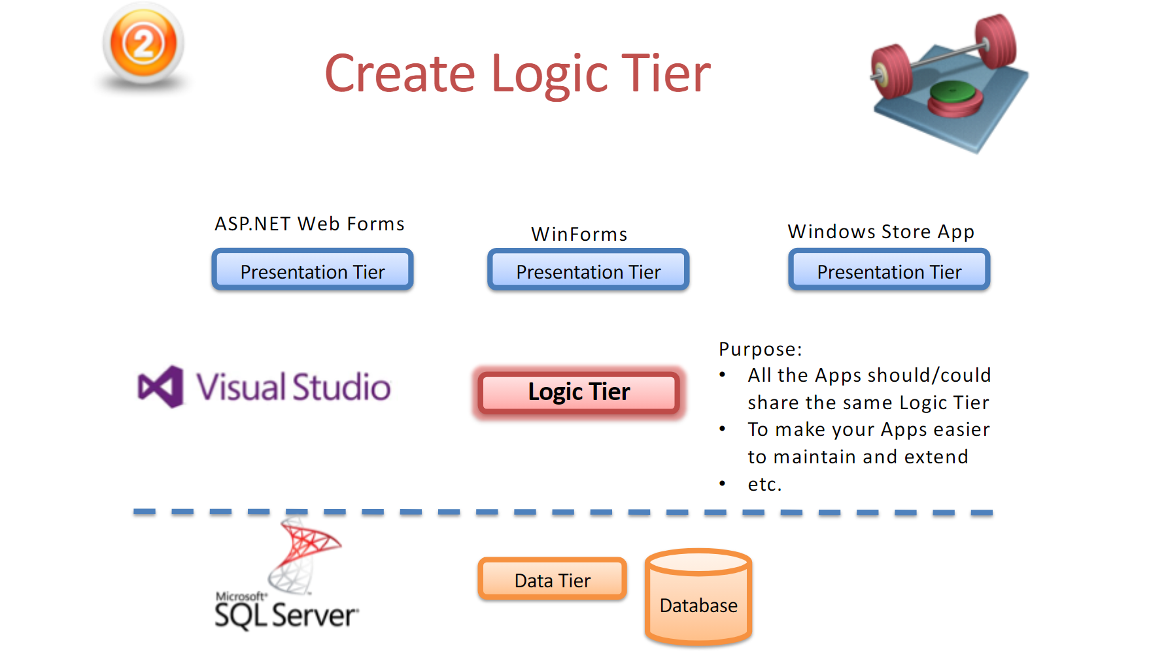

Slide 21
Project Demonstration
Microsoft Azure, commonly referred to as Azure also is a cloud computing service created by Microsoft for building, testing, deploying, and managing applications and services through Microsoft-managed data centers. It provides software as a service (SaaS), platform as a service (PaaS) and infrastructure as a service (IaaS) and supports many different programming languages, tools, and frameworks, including both Microsoft-specific and third-party software and systems.
Azure, announced at Microsoft's Professional Developers Conference (PDC) in October 2008, went by the internal project codename "Project Red Dog",^{[5]} and formally released in February 2010, as Windows Azure before being renamed to Microsoft Azure on March 25, 2014.

Slide 22
.
Azure Active Directory is used to synchronize on-premises directories and enable single sign-on. [1]
Azure Active Directory B2C allows the use of consumer identity and access management in the cloud.
Azure Active Directory Domain Services is used to join Azure virtual machines to a domain without domain controllers.
Azure information protection can be used to protect sensitive information

Slide 23
ARM Templates
An ARM template is a JSON (JavaScript Object Notation) script. This script includes the resource(s) that are being deployed to an Azure Resource Group.
In most cases, resources are provisioned from the Azure Portal. But, what if we want to repeat a deployment more than once? At that point the concept of ARM Template came up, which we can use to make the deployments by running a simple PowerShell script.

Slide 24
How can way Create An ARM Template
There are more than one ways to get started with ARM Template:Azure Portal (From the Automation Script & Custom deployment).
GitHub (From the section Azure Quick Templates).
Visual Studio.
Visual Studio Code.

Slide 25
,
Azure Portal:
The first place we can view an ARM Template is the Azure Portal. There are several ways to work with ARM Templates like Automation Script (when a resource is deployed), custom deployment (deploy resources using common templates, Load templates from GitHub or deploy one from scratch). Automation Script:
From the Virtual Machine left blade, click Automation script. This is the easy way because we can view and download the template just by clicking some buttons.

Slide 26
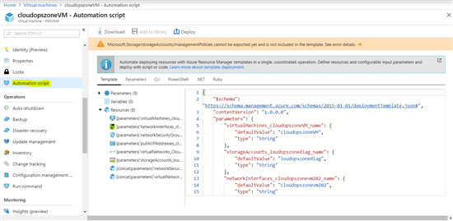

Slide 27
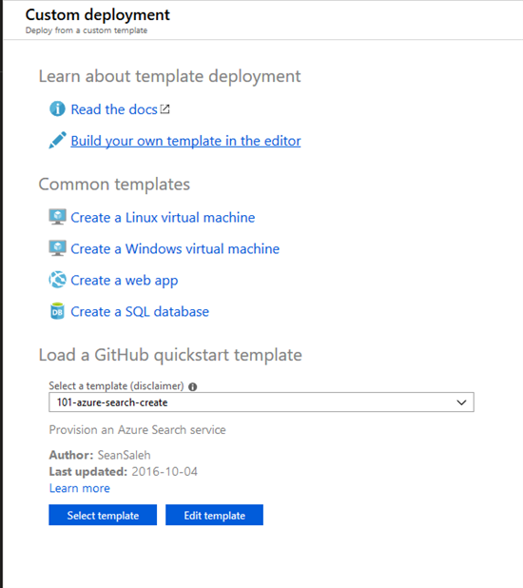
Custom Deployment : To create a custom deployment we must follow the next steps : Search for the service [Template deployment] - Select and click Create .

Slide 28
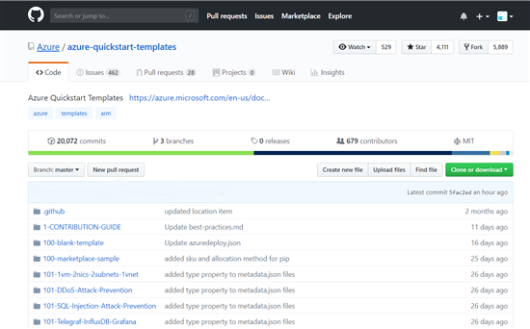
Github : A huge collection of ARM Templates can be found on GitHub. We just need to open an internet browser, type in the address https://github.com/Azure/azure-quickstart-templates , and click Enter.

Slide 29
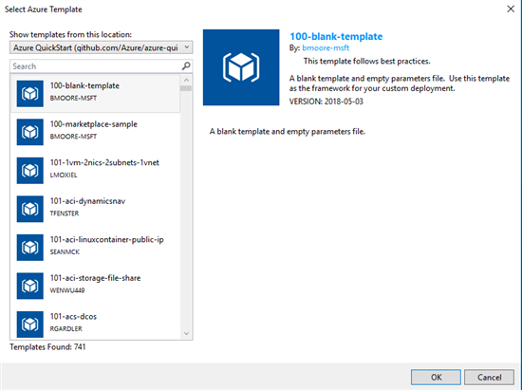
Visual Studio : We can also deploy an ARM template from Visual Studio, we just need to follow the next steps. From File - New - Project..., select Visual C# - Cloud - Azure Resource Group and click OK.

Slide 30
How To Deploy An ARM Template
In the following example suppose that we have already created an ARM template and are trying to deploy it. When we download the template.zip file and unzip it we can see the following files :deploy.ps1 : A powershell script for template deployment.
deploy.sh : A bash script that will deploy the ARM template.
deployer.rb : A ruby script that will deploy the ARM template.
DeploymentHelper.cs : A C# file with the template deployment.
parameters.json : A JSON file that includes all the parameters for the deployment.
template.json : A JSON file that include the main deployment.
After we do all the necessary configuration in the parameters.json and template.json files, we execute the following script. Login-AzureRmAccount
Set-AzureRmContext -SubscriptionId 'aaaaaaaa-bbbb-cccc-dddd-eeeeeeeeeee'
New-AzureRmResourceGroup -Name ResourceGroupName -Location "West Europe"
New-AzureRmResourceGroupDeployment -Name ExampleDeployment -ResourceGroupName ResourceGroupName `
-TemplateFile C:\MyTemplates\template\template.json `
-TemplateParameterFile C:\MyTemplates\template\parameters.json

Slide 31
.
Thank you

